Slide 1
Online Prediction Analysis
201285003 201285087
201285006 201285088
201285046 201285092
201285058 201285102
201285070

Slide 2
Problem Statement
Estimating success of a new business is an important venture that entrepreneurs need
There are several common components that predict the success of a new business
Strength of the management team
Marketing surveys
Area of industry

Slide 3
Why Predictive Analysis ?
Feedback on business concepts through traditional marketing surveys
Internet is an effective interactive medium
Online tools have proven to be very successful with entrepreneurs
An entrepreneur can predict the outcome of the new business concept and estimate market reaction through “ONLINE PREDICTION ANALYSIS TOOL”

Slide 4
Online Prediction Analysis Tool
Predictive analytics deals with extracting information from data and using it to predict trends and behavior patterns
A website where a naive user can submit the data and get the results without having any knowledge of machine learning
User can select different algorithms to predict the results

Slide 5
Technologies used
Languages used : Java, Python
Web technologies : Html, Jsp , Javascript, Ajax, Servlets

Slide 6
Flow of inputs and outputs
User input through simple web interface
Selection of algorithm
Output/ results

Slide 7
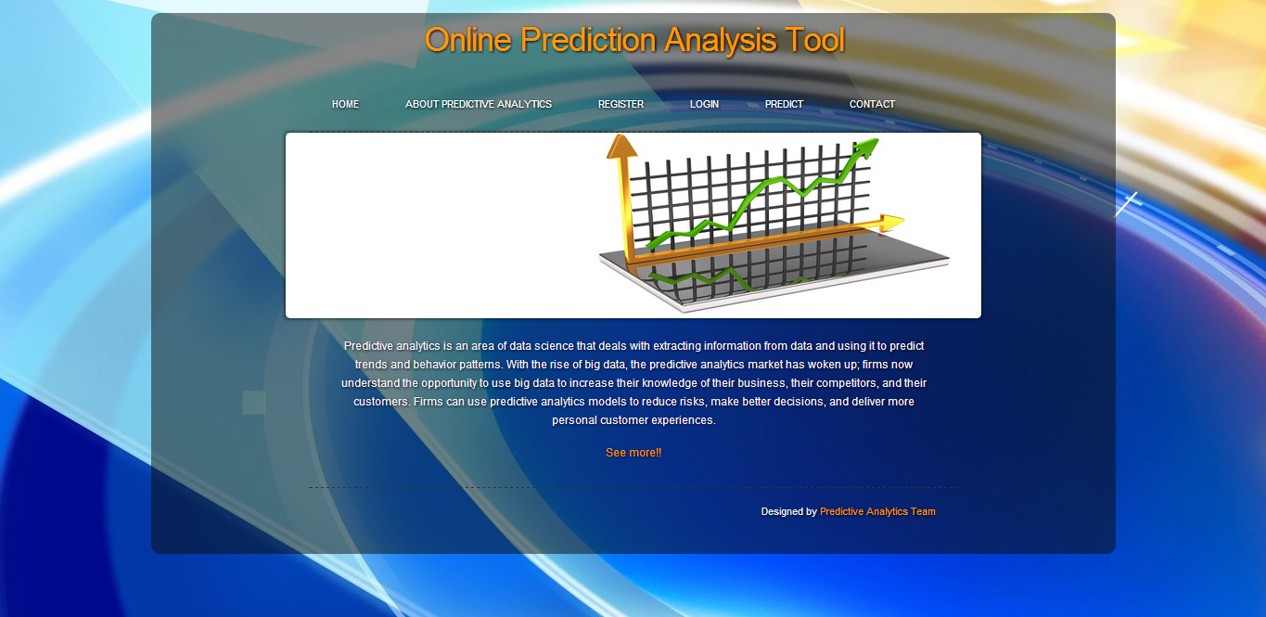
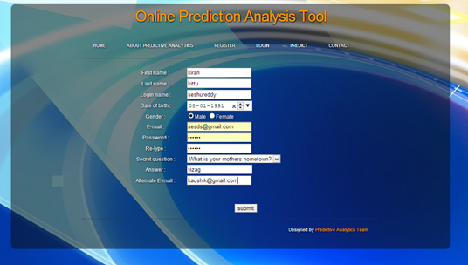
Screens

Slide 8
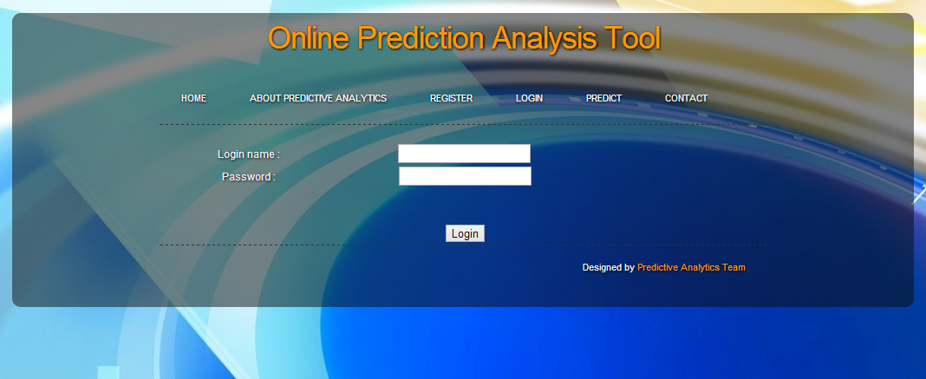
Screens

Slide 9
Algorithms used
Decision Trees
Neural Networks
Correlation
Linear Regression
Feed Forward Back Propagation
Naïve Bayesian
K-means
S.V.M

Slide 10
Naive Bayes Classification Algorithm
To Predict one or more discrete variables, based on the other attributes in the dataset.
How.?
The Naive Bayes algorithm calculates the probability of every state of each input column, given each possible state of the predictable column.
For. .?
Predicting a discrete attribute
Flag the customers in a prospective buyers list as good or poor prospects.
Calculate the probability that a server will fail within the next 6 months.
Categorize patient outcomes and explore related factors.

Slide 11


Logistic Regression algorithms
Predict one or more continuous variables, such as profit or loss, based on other attributes in the dataset.
How.??
Logit =
Used At:
To make predictions about outcomes, such as risk for a certain disease.
Explore and weight the factors that contribute to a result. For example, find the factors that influence customers to make a repeat visit to a store.
Classify documents, e-mail, or other objects that have many attributes.

Slide 12
Feature reduction
Junk attributes removal
Reduction of features
Less computing time

Slide 13
Decision trees
Predictions based on the relationships between input columns in a dataset
Identifies the input columns that are correlated with the predictable column
Uses feature selection

Slide 14
Applications
Real estate
Health care industry
Architecture
Retail business

Slide 16


